Slide 1
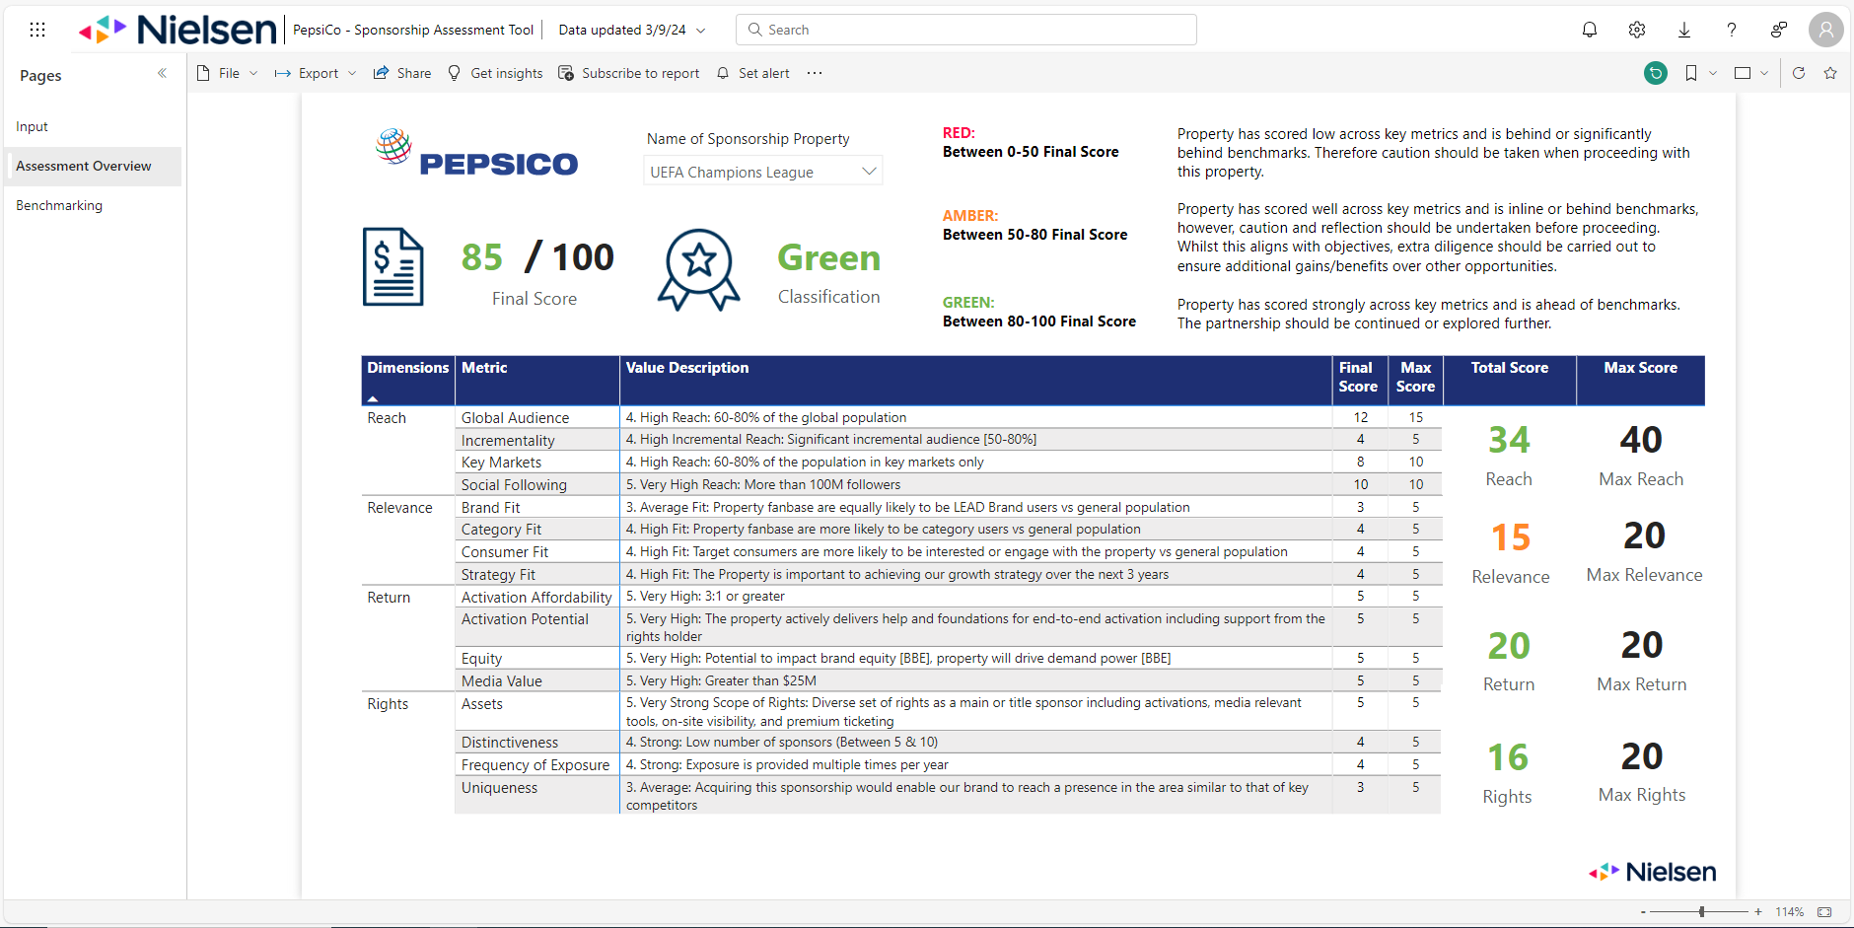

Slide 2
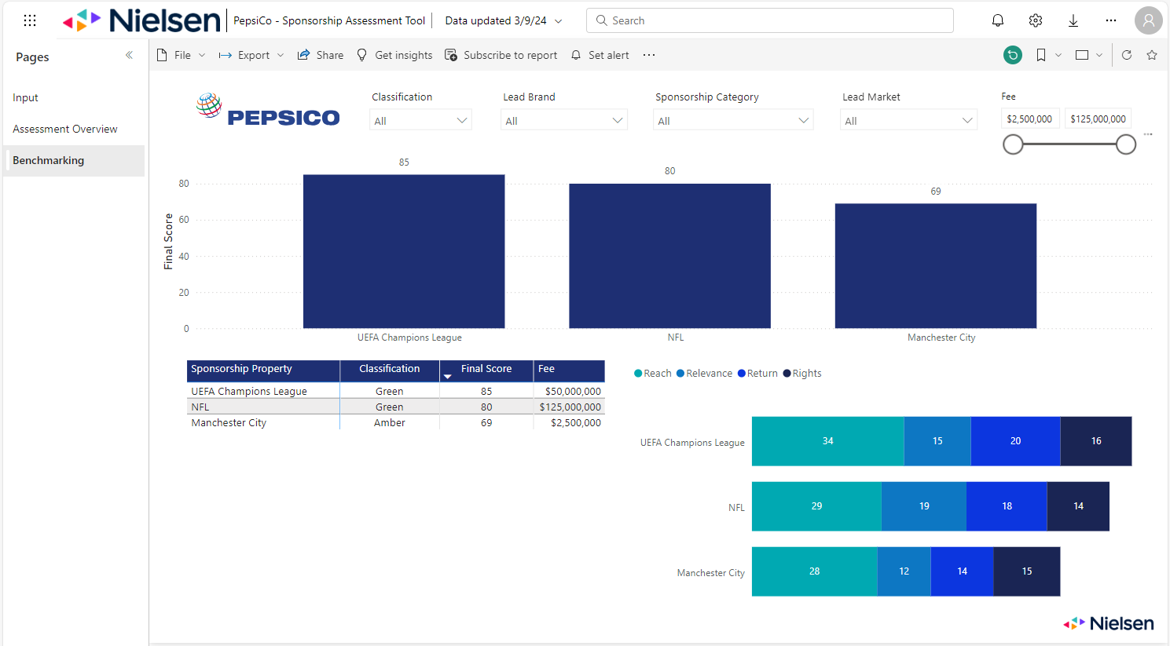

Slide 3
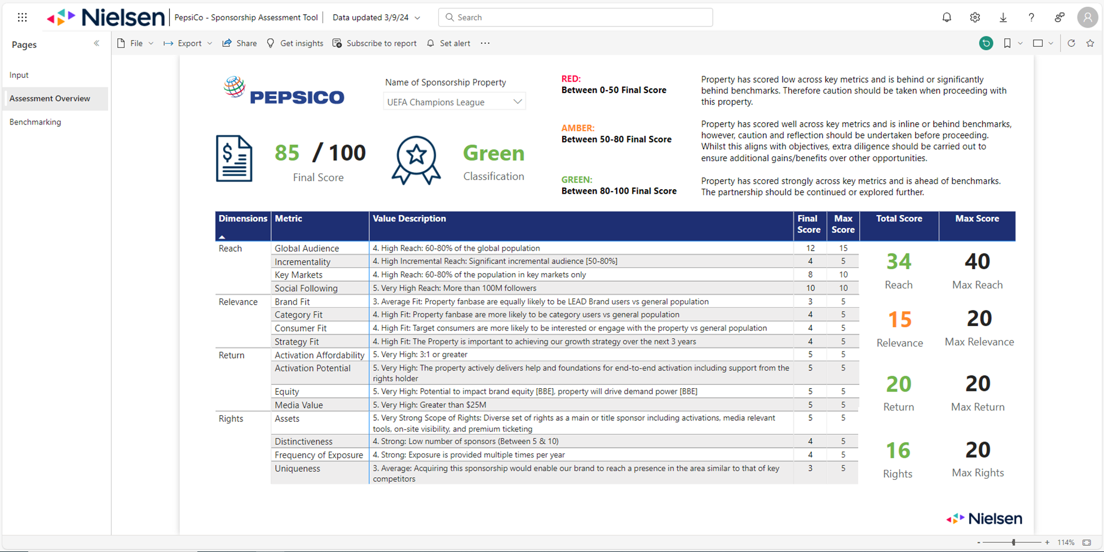











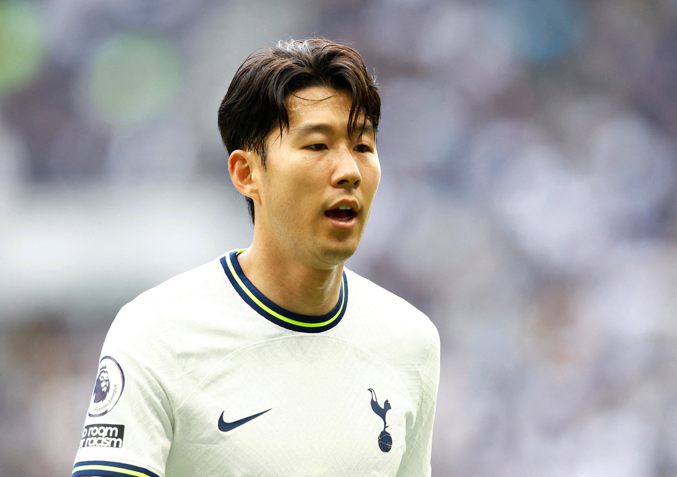
Add score to circle & possibly scale circles to size based on score
Final score & classification by property
FWC
UCL
NBA
UWCL

Slide 4
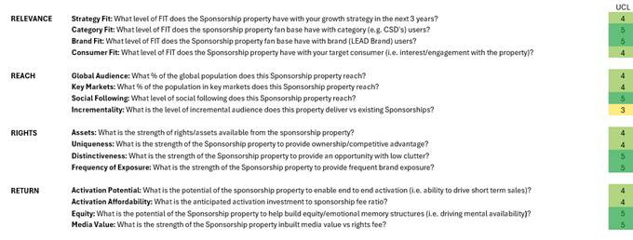
Instructions
Assessment overview:
Add 4R icons from slide 3 to assessment overview.
Colour code Q scores across 4R’s with gradients of traffic lights.
Benchmarking dashboard:
4R table with bubbles
Slide 3 = new benchmark dashboard.
Can this be done in a Qualtrics dashboard?
Property of focus [able to choose property to benchmark off of]
Ability to choose other properties [~4] to include in the table below focus property]
Add score into bubble.
Scale bubble size to score.
Scatter plot
Plot each property with single final score.
Add traffic light gradient as per scatter plot graph.
Look at plotting logos vs text. Logo’s might not be possible.

